Slide 1
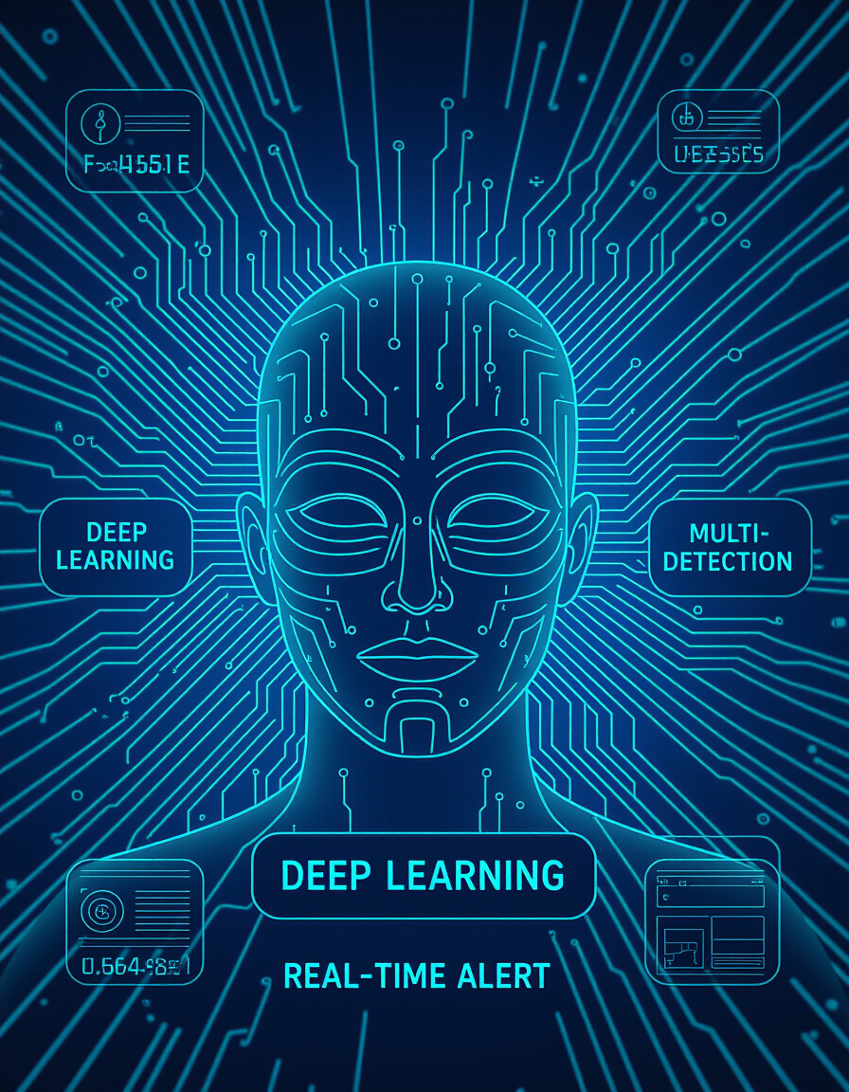

PROBLEM STATEMENT: SMART INDIA HACKATHON 2025 Internal VIT hackathon Round 1:
PSID : SIH25012
PS TITLE : Automated Attendance System for Rural Schools ( GOVT. OF PUNJAB )
Theme : Giving every student their right with help of Technology
PS category : Software
TEAM ID : VIT-147 ( panel 6 )
TEAM Name : FACE HONEYCOMB

Slide 2
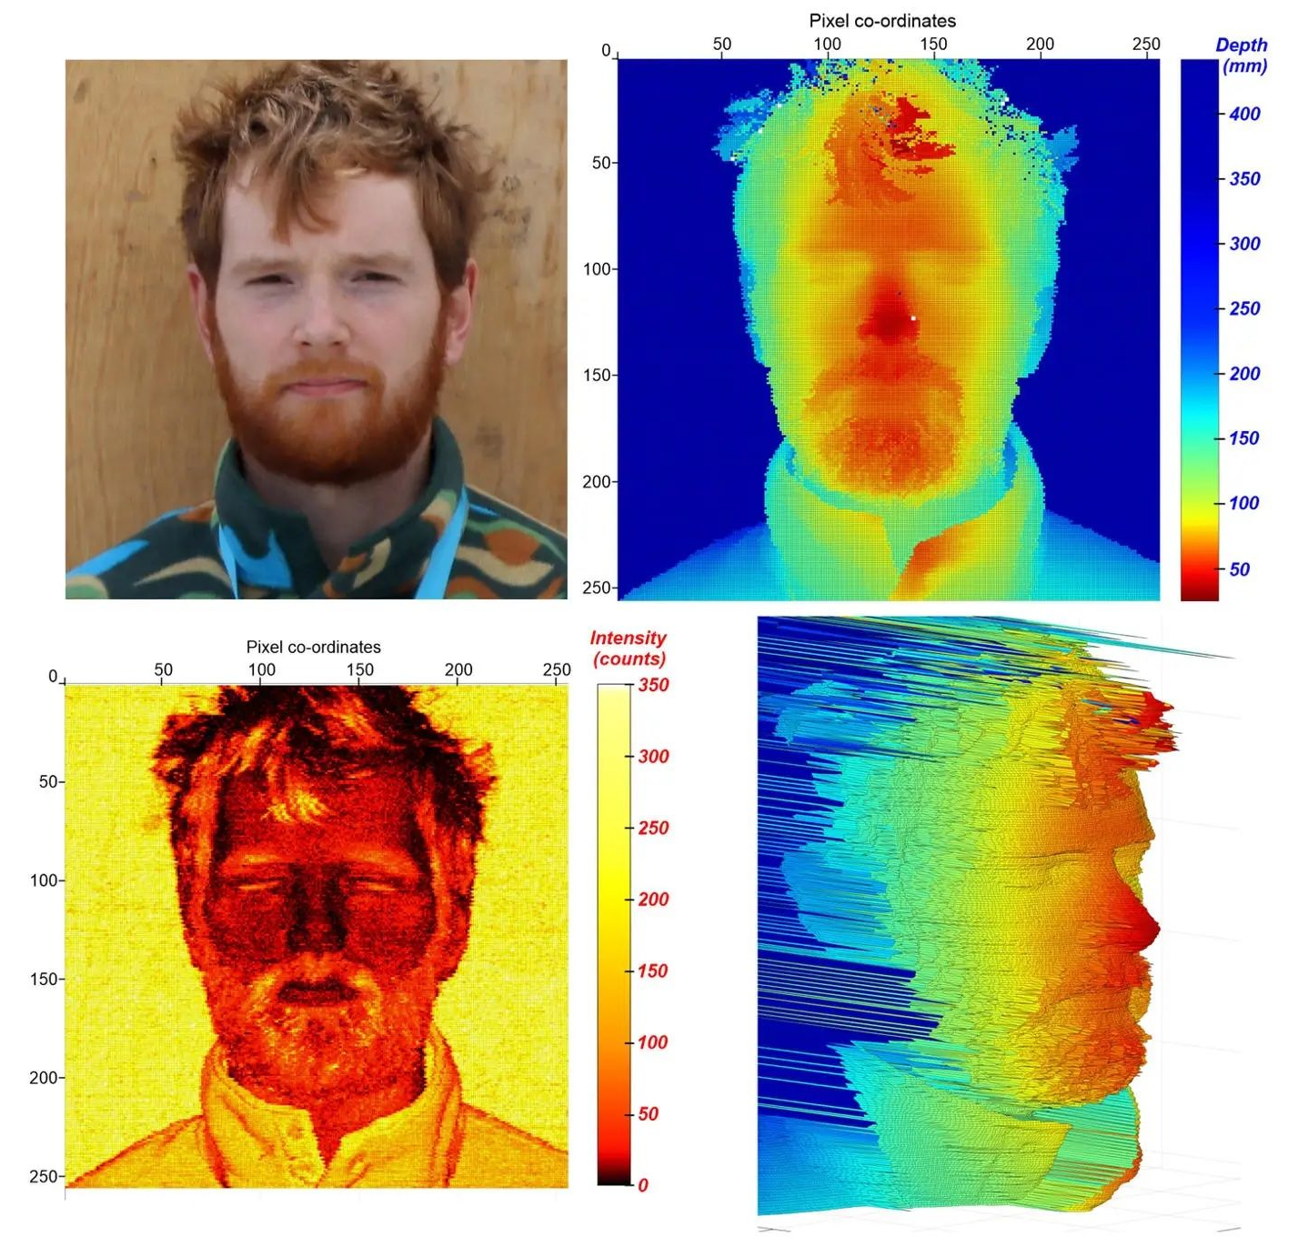
WHY NOT PREEXISTING METHODS?
There are many types facial recognition which is greatly expensive to be implemented in rural schools
3D Facial Recognition ( BAD SOLUTION , EXPENSIVE )
Infrared/Thermal Facial Recognition (BAD SOLUTION , High maintenance cost)
LiDAR-Based Recognition (BAD SOLUTION, expensive )
WHY OUR METHOD? : CNN - ML
No Specialized Hardware Needed - Runs on commodity hardware (CPU/GPU).
Software-Only Approach - Open-source frameworks like TensorFlow/PyTorch make it nearly free.
Scalable and Flexible - Can be deployed on local machines , Doesn’t require ongoing licensing fees
Great Accuracy – achieve 95–99% accuracy on 2D photos
EXPENSIVE – NOT APPLICABLE TO THIS AREA
Ref : https://www.popularmechanics.com/science/a63724352/snspd-lidar-facial-recognition/

Slide 3
OVERALL PROJECT MECHENISM IN BRIEF
EXPLAINED WITH FLOW-MAP
05 : EMBEDDING IS SEARCHED USING MATH SEARCH METHODS
06 : Euclidean distance (L2 norm) (Cosine similarity is mathematically equivalent)
01 : THE CAMERA TAKES INPUT IMAGE
07 : THEN FINALLY IF MATCHED > 95% THEN RETURN ID TO RETRIEVE PERSON IDENTITY
02 : FACE DETECTION TRACKS FACE AND CROPS FACE
LINK : https://www.kaggle.com/datasets/stoicstatic/face-recognition-dataset
SOURCE : Nikit Periwal – KAGGLE
LICENSE - CC0 1.0 Universal CC0 1.0 Deed
The person who associated a work with this deed has dedicated the work to the public domain by waiving all of his or her rights to the work worldwide under copyright law, including all related and neighboring rights, to the extent allowed by law
03 : THE CROPPED FACE IMAGE IS PUSHED INTO THE MAIN CNN MODEL
04 : THE CNN MODEL FIND CONVERTS IMAGE INTO 128D VECTOR EMBEDDING
A depth mapping AI will also be embedded
to tackle fake faces such as photos

Slide 4
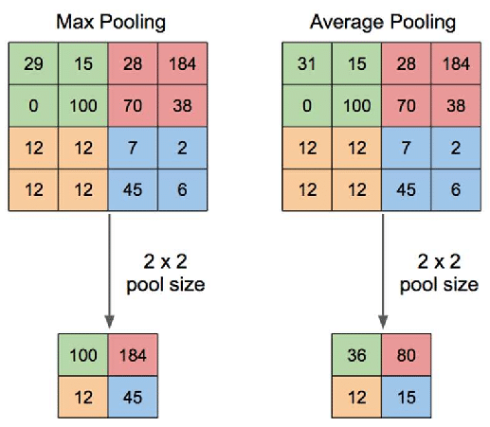
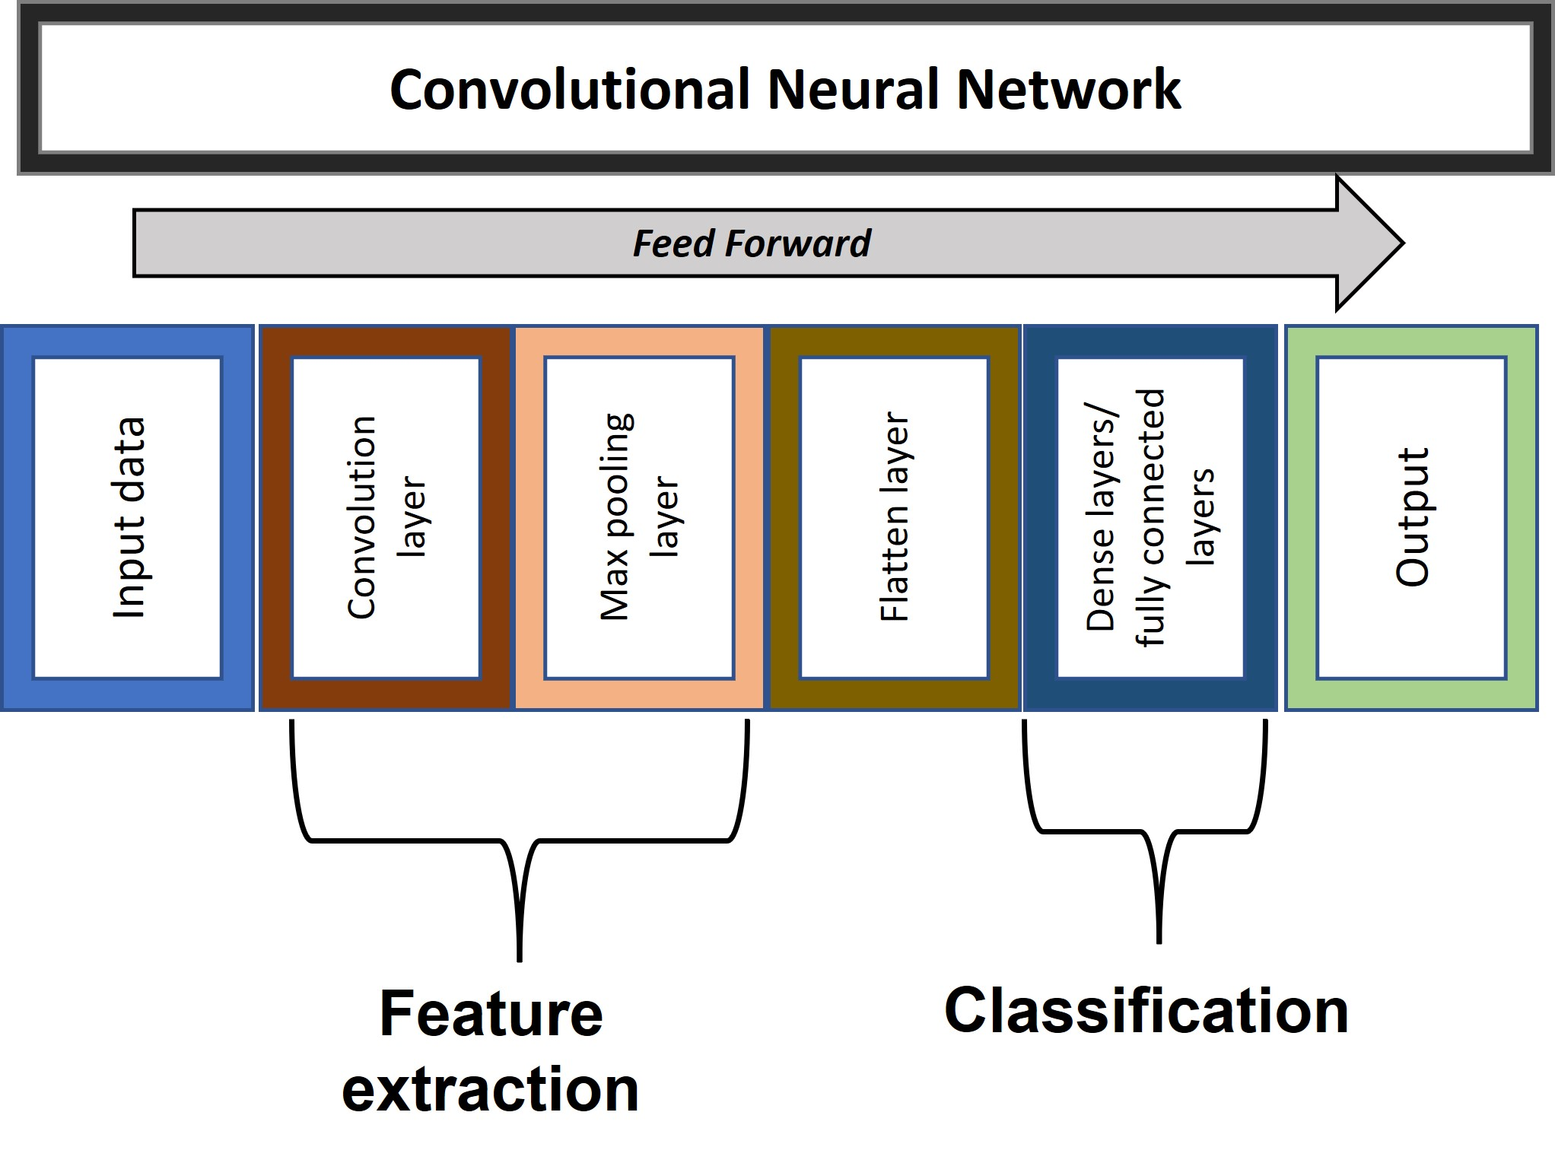
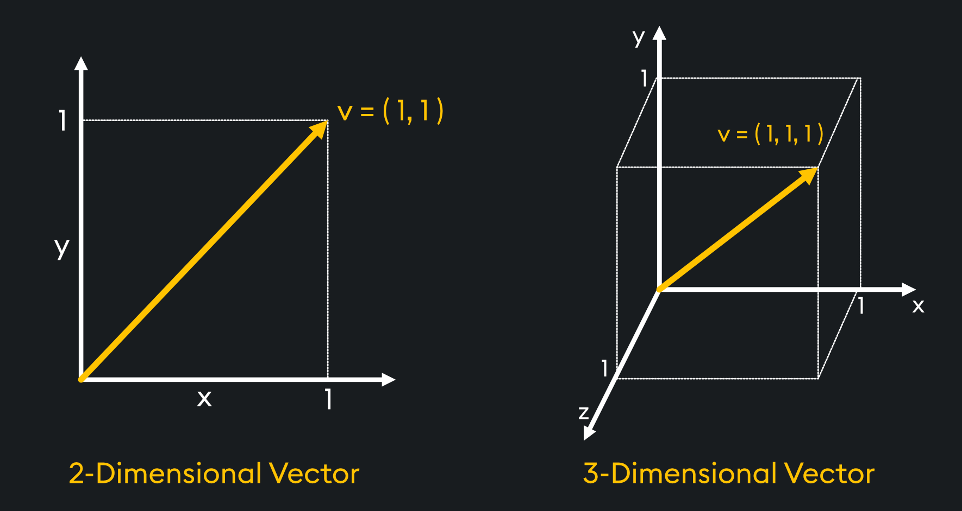
The Convolutional Neural Network HOW IT WORKS ?
1. Input Layer
An image is decoded, resized to 160x160 pixels, and converted into a numerical array.
2. Feature Learning (CNN Layers + RELU + POOLING)
Convolution: The model learns key facial features, starting from simple edges and building up to complex parts like eyes and noses.
ReLU (inside Conv2D) - Keeps only useful signals
Max Pooling: The image is simplified, reducing its size while keeping only the most important features.
3. Embedding (Dense Layer)
Learned features are converted into a unique 128-number "face signature" (vector embedding).
This signature is the face's unique mathematical identity within the model.
4. Matching & Decision
A similarity score is calculated. If the score is above our threshold (e.g., 95%), we declare it a match.

Slide 5
FUTURE ASPECTS & GOALS
We plan to add alot of features in the final product such as :
END TO END ENCRYPTION : This ensures that data of every staff and student is protected upto military standards , we will encrypt the embedding set using best encryptions available and also look upto quantum proof encryption as our further research focus.
BLOCKCHAIN : This ensures that no fake data can be generated in the embedding and only the real identity is verified
Smarter System : Implementation of LLM (Large Language Model) based monitoring over the data will keep it more automated and reliable
PARENT – STAFF APP : We plan to provide integrated app linked with the system that gives live updates about which student is present and which student is out of the classroom with respect to timing.
CUSTOMISED OPTIONS : We plan to add custom options for special occasions such as EVENTS , MID-DAY MEALS , etc. WITH super easy user interface
DISASTER PROOF : If one server goes down (due to earthquake, fire, flood, or hardware failure), the system automatically fetches data from another location.

Slide 6

USER INTERFACE PROTOTYPE & PLANS
We plan to keep it :
FUN and shouldn’t feel like a chore to scan
Will provide with special quotes unique with each person
Vibrant and colorful design (non tech design)
Jargon free approach to feel relatable and personalized
Use of regional languages into the system
Fun animations and smooth experience
THIS IS JUST A PROTOTYPE – WE PLAN TO PROVIDE MUCH BETTER DESIGN

